Slide 1
CloudC
Assignment

Slide 2
Team Members:
Aditi Awasthi
Eleanor Prashamshini
Harshith Arun Kumar
Myna P
Paras Naren
Pragnya Suresh
Adithya
Hari Prasad Ashok

Slide 3
Task:
Create a NAS storage
Allow only a part of the shared storage (10 GB)to be accessed
Restrict the type of files that can be stored (media and mp3 files should not be given access to be stored)

Slide 4
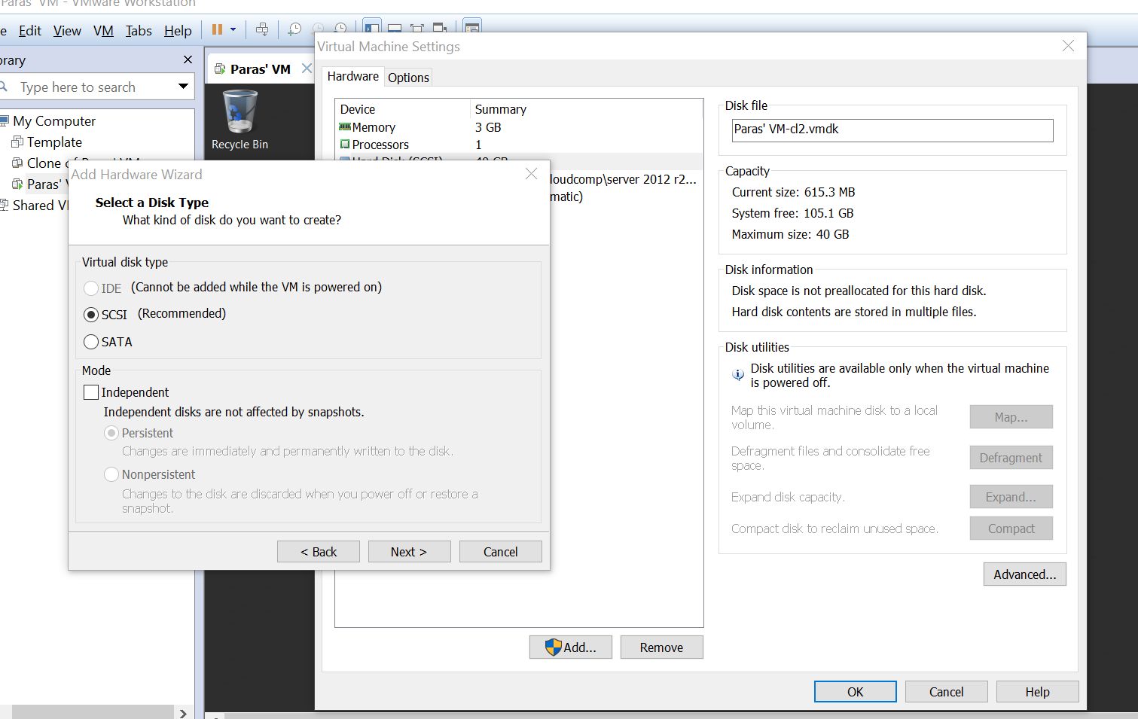
Enter the VM settings and select Add new Hard disk
Create a virtual disk of type SCSI and proceed to next.

Slide 5
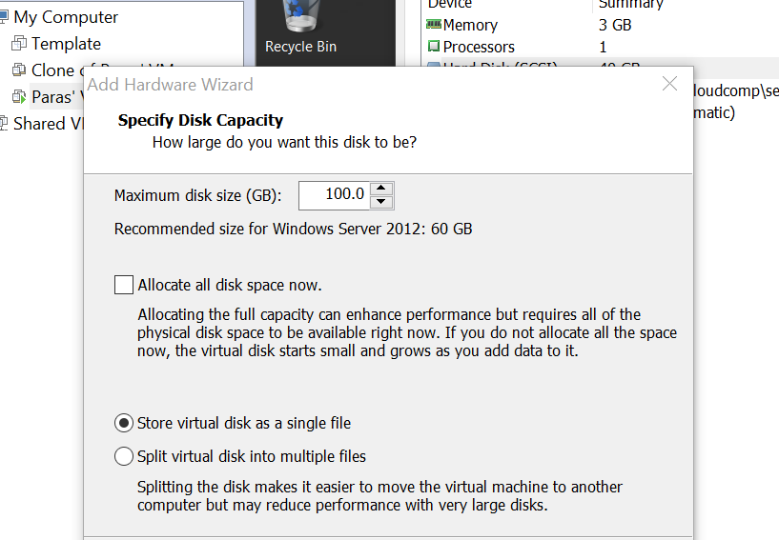
Enter the desired size of the virtual disk (100GB) and store it as a single file.

Slide 6
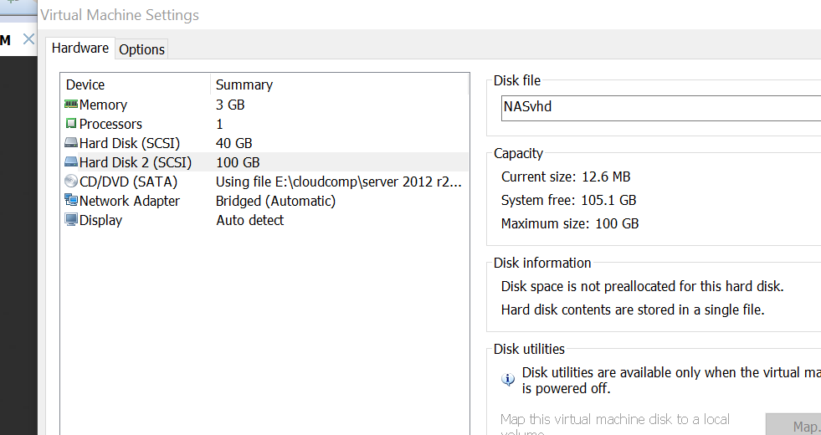
Hard disk of capacity 100GB has been created.

Slide 7
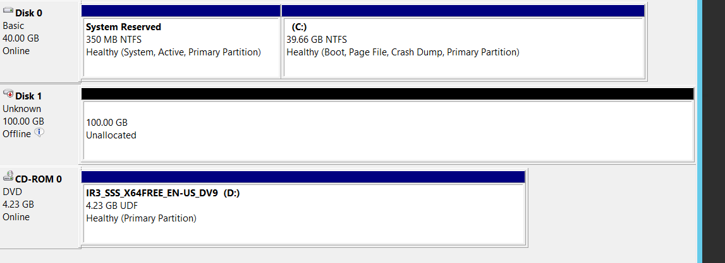
The disk created is unformatted and is currently in the offline mode.
Right click->online
Right click->New Simple volume

Slide 8
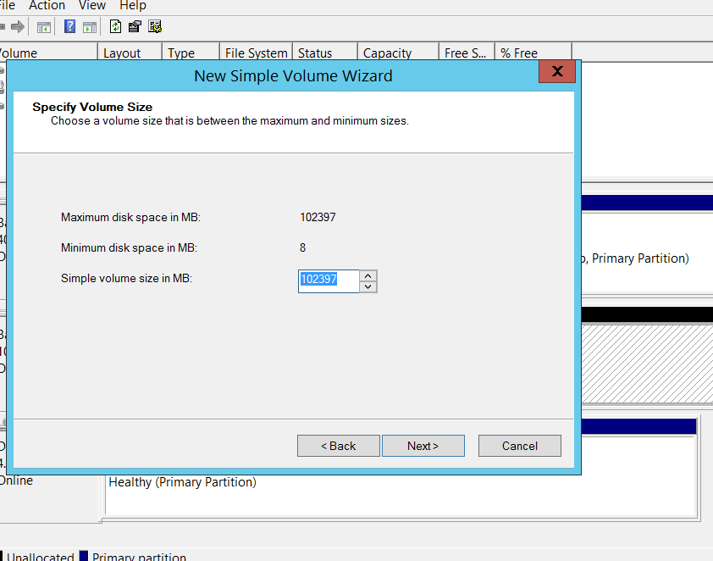
Choose a volume size such that it is in between the maximum
and minimum disk spaces specified above.

Slide 9
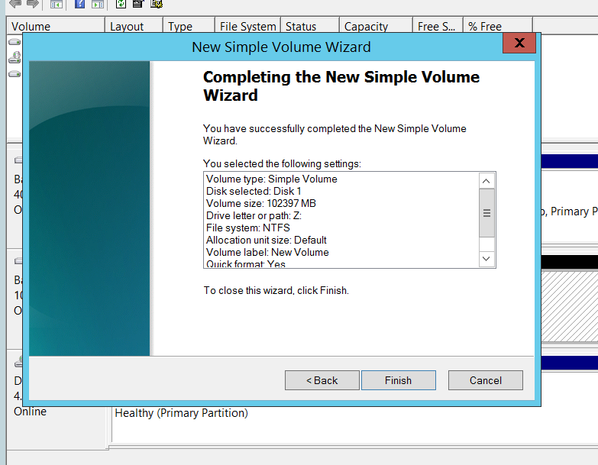
The new simple volume has been successfully created and exists in Drive Z:

Slide 10
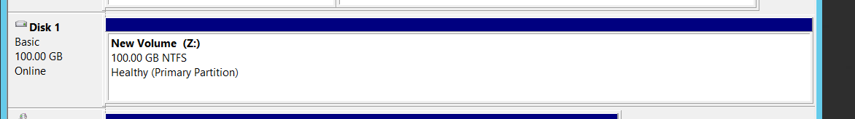
The disk is now formatted and the volume created exists as
a single block with no partitions.

Slide 11
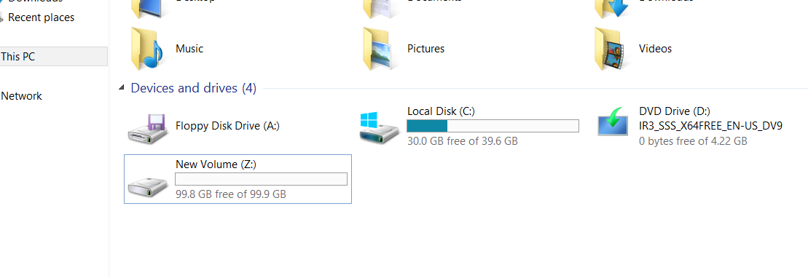
The volume is created in the Z drive .This volume is to be shared.
Right click->Properties

Slide 12
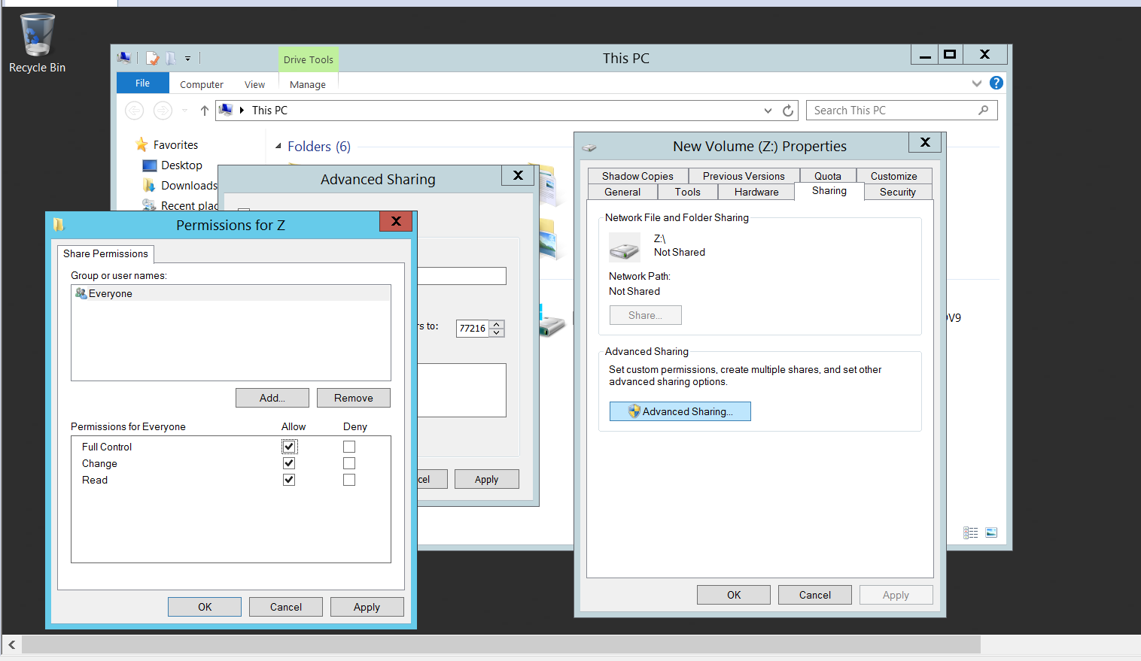
Sharing tab->Advanced sharing->select all checkboxes to enable this
Volume to be accessed by the client.

Slide 13
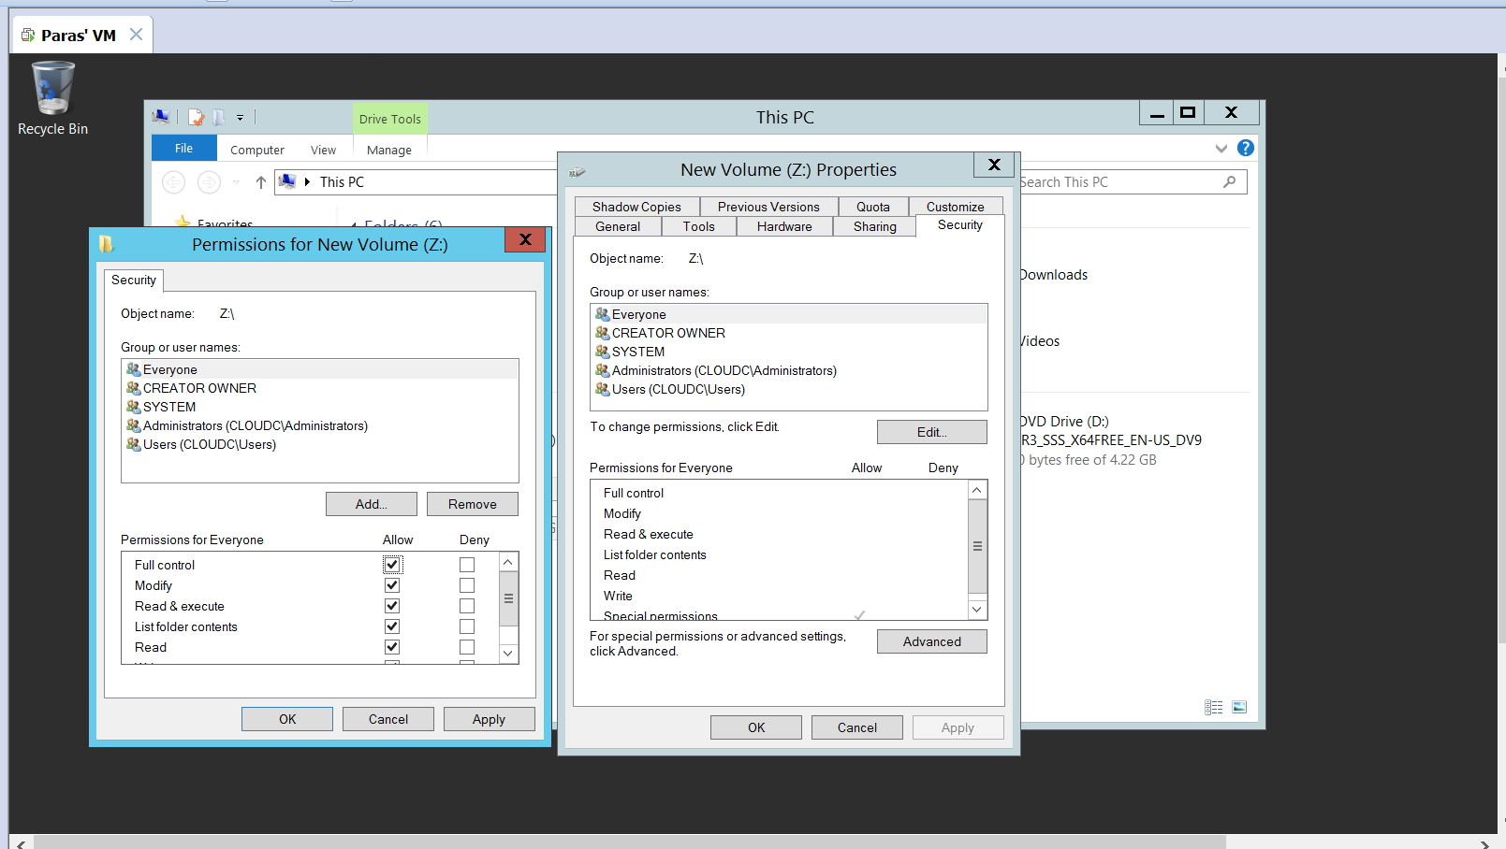
In the Security tab, choose ‘Everyone’ in order to enable users to view the disk created.

Slide 14
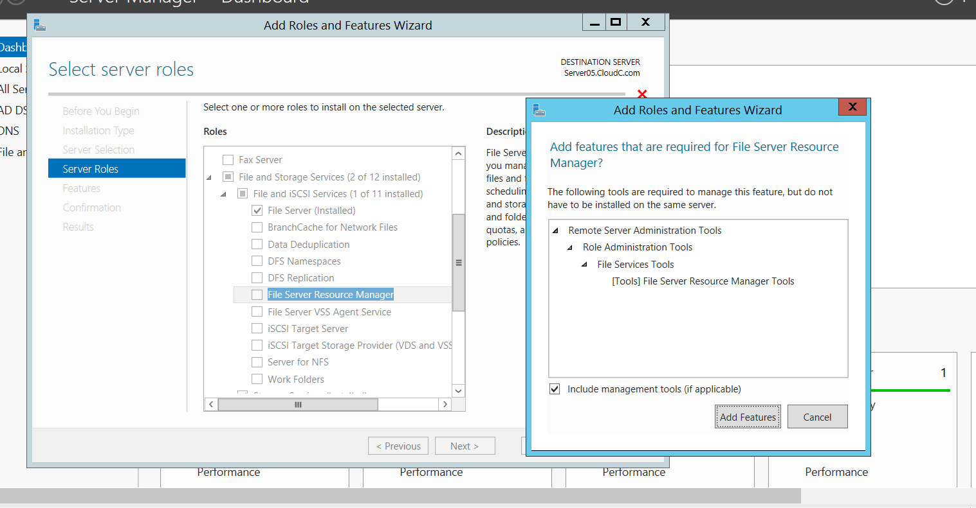
Server Manager->Add Roles and Features
File and Storage services
File Server
File Server Resource Manager

Slide 15
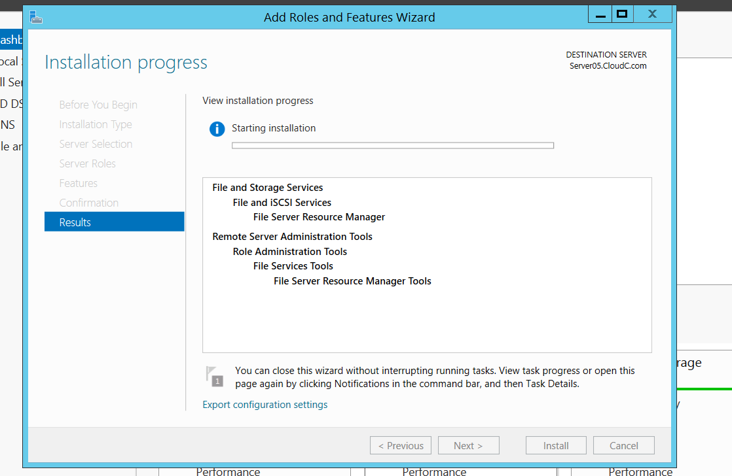
Click install to complete the installation of the selected
Features.

Slide 16
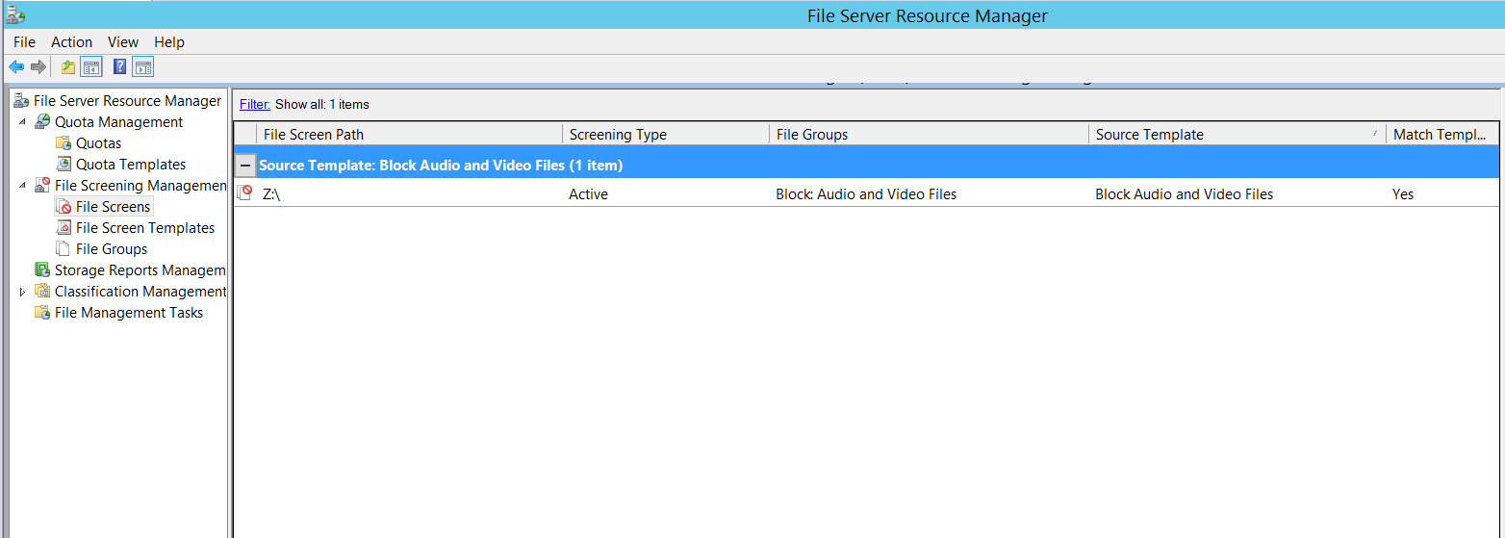
Search and open File Server Resource Manager
Select File Screening Management tab -> File Screen
Right click and select Create new file screen

Slide 17
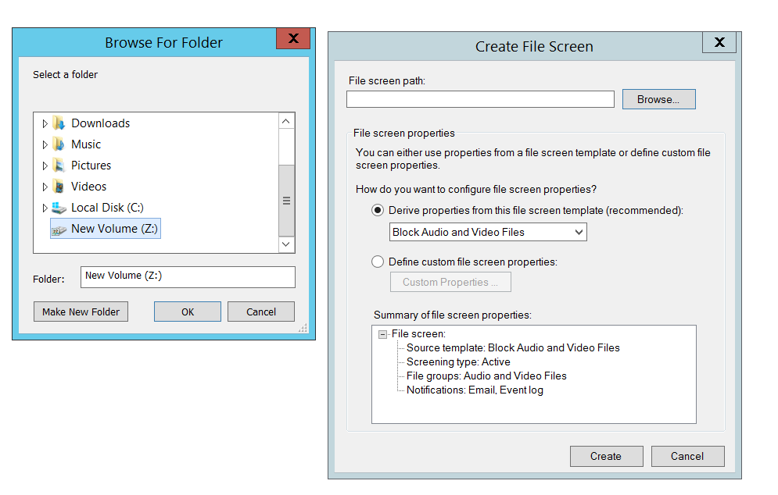
Browse for the location of the created disk, New Volume(Z:)
Under Derive properties, select Block Audio and Video Files
Select Create

Slide 18
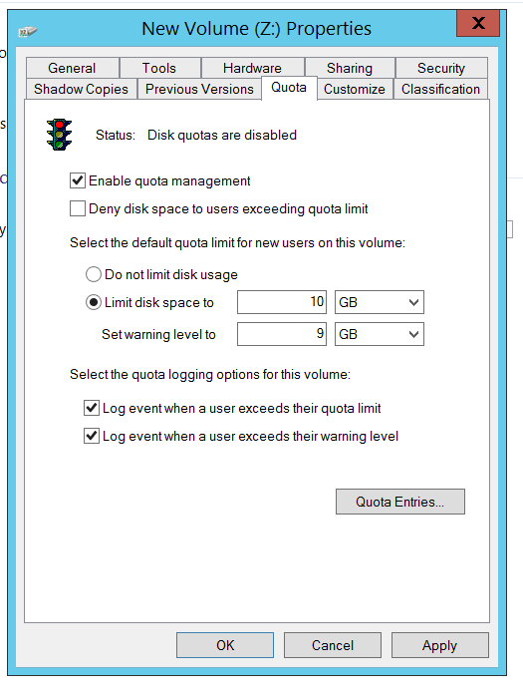
Right click the New Volume(Z:) > Properties > Quota tab
Set Limit disk space to 10 GB
Set warning level to 9 GB
Apply the settings

Slide 19
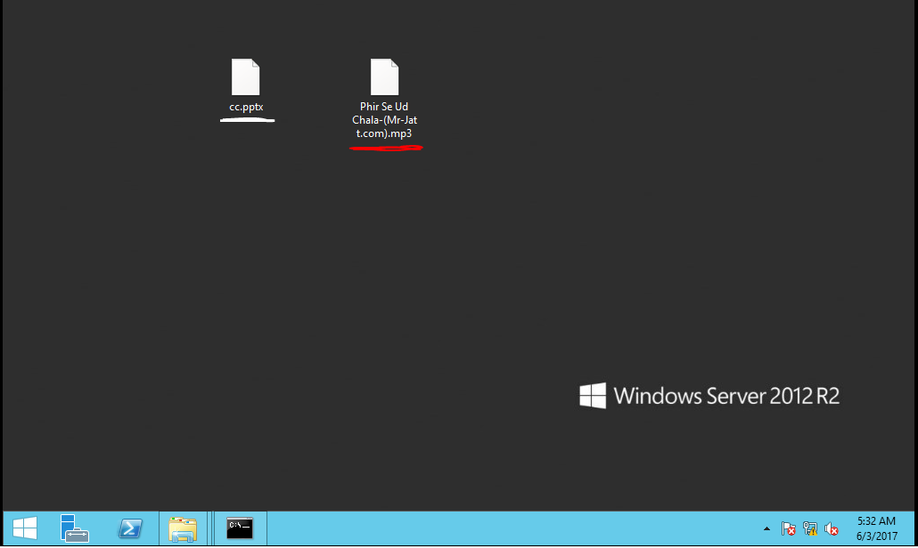
These are the two files that are going to be copied to the shared
Storage space. The first file is a ppt document while the second one
is an mp3 file.

Slide 20
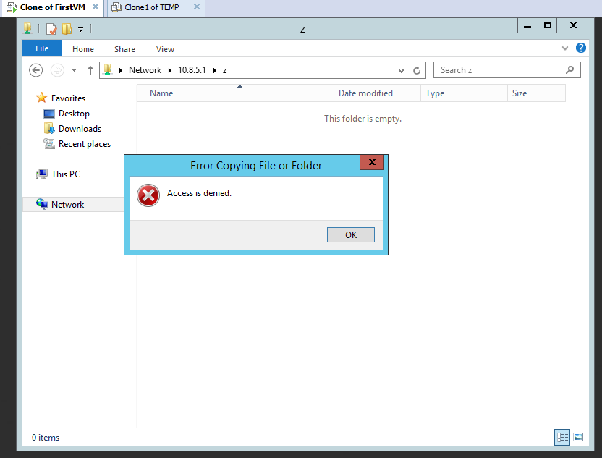
As per the restrictions imposed, the mp3 file is denied access to the shared
folder.

Slide 21
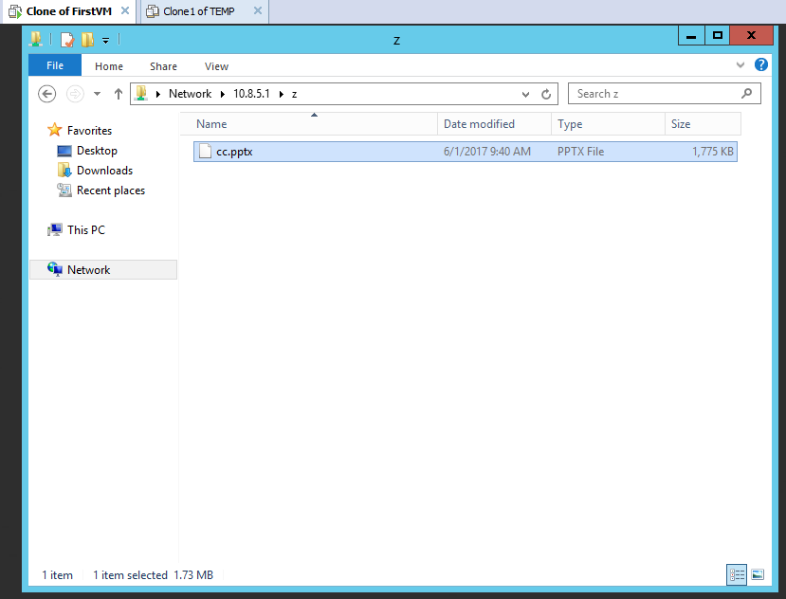
The Document file has been copied successfully.

Slide 22
THANK YOU

